Slide 1
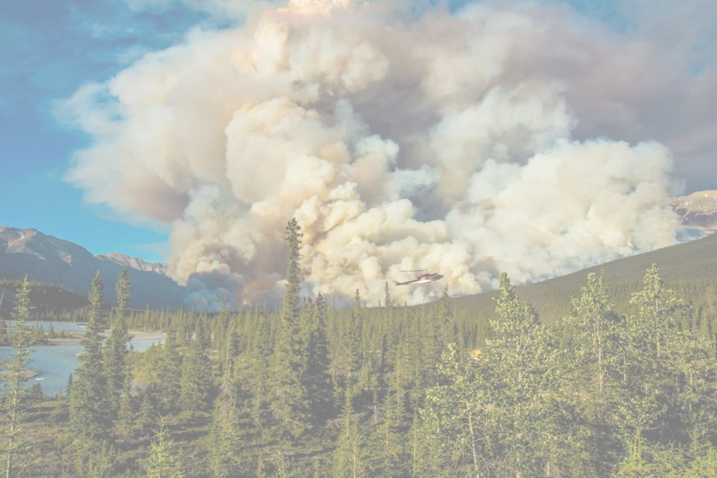
Biomass-based cellular automaton for exploring wildfire
By J Kahn and Helen Miller
QERM 497
March 7, 2023

Slide 2
Presentation Roadmap
Ecological Context
Model Description
Experiments + Results
Conclusions
Notes:
H – Ecological context + model description
J – Experiments and Results + conclusions

Slide 3
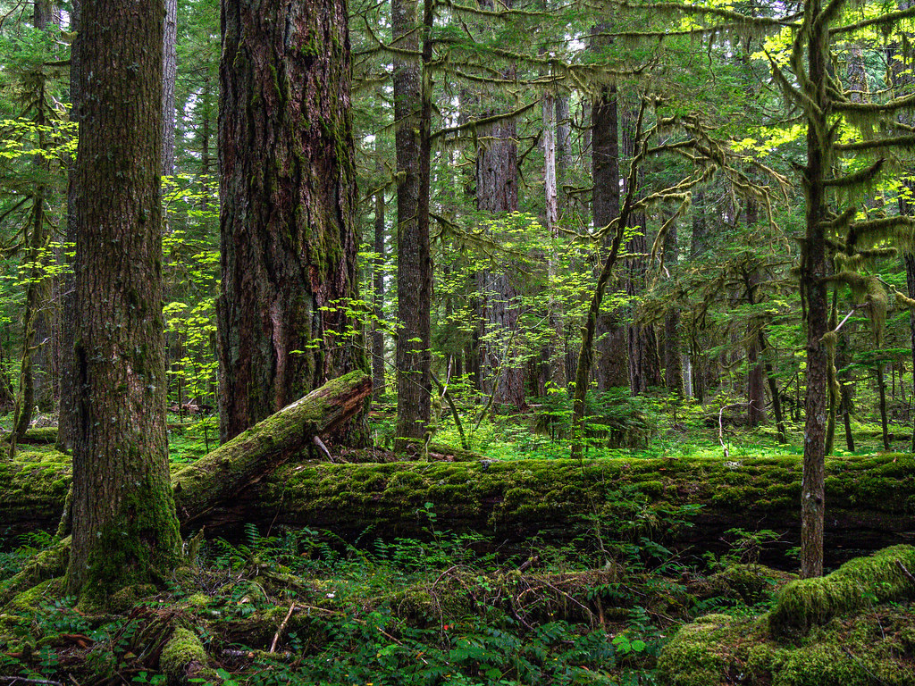
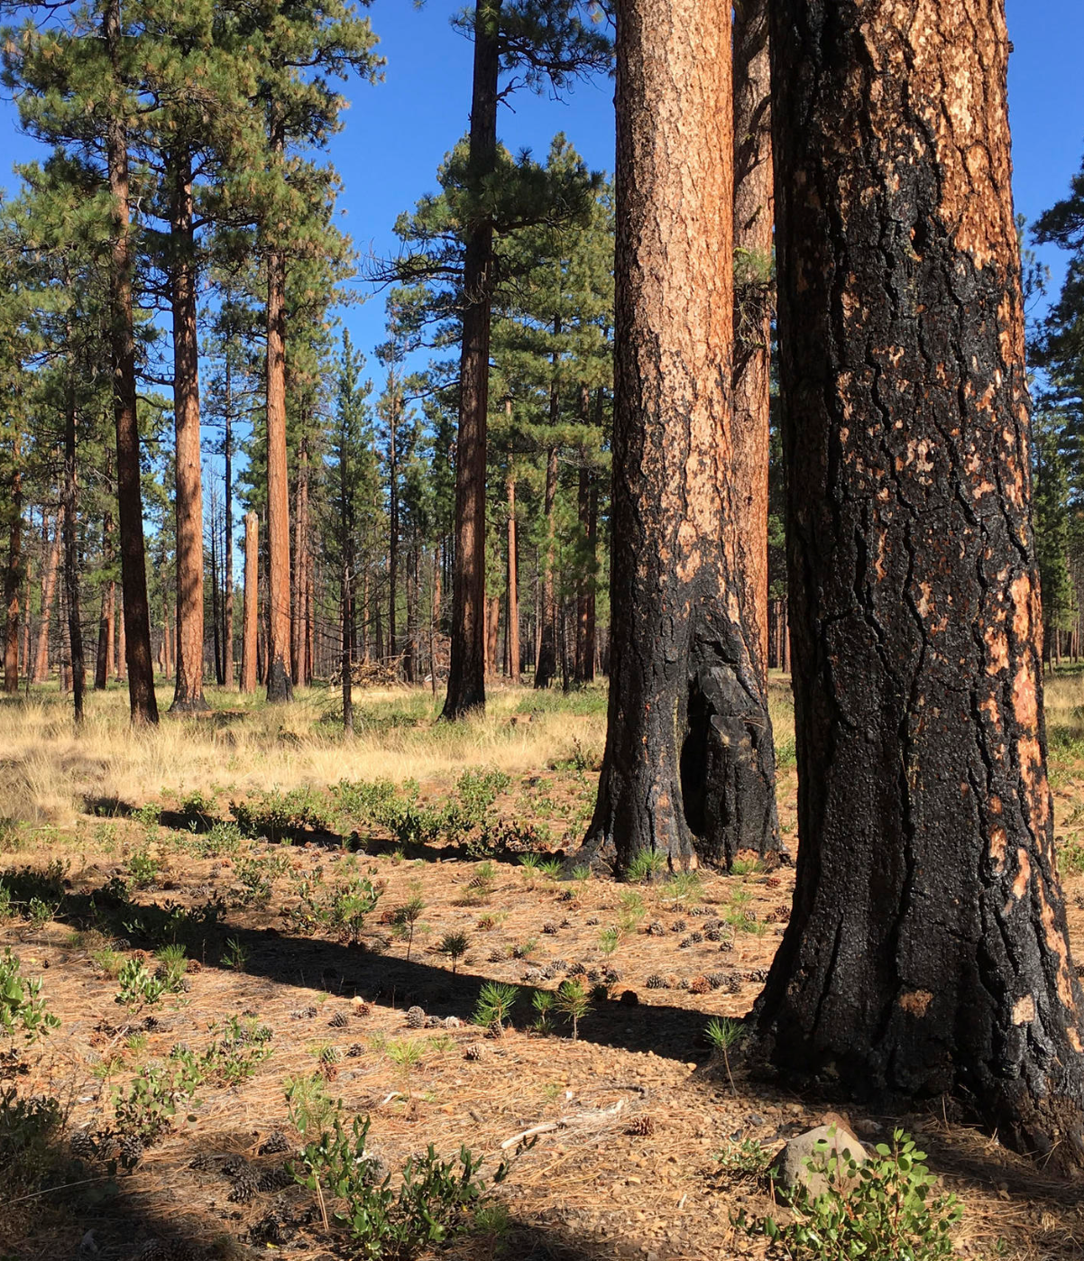
Ecological Context
Western Cascade forest
Eastern Cascade forest
High precipitation
High biomass accumulation
Infrequent, high-severity wildfire
Dry climate
Sparser forest, lower biomass
Frequent, lower-severity wildfire
Notes:
https://www.flickr.com/photos/sigmaeye/49928298063/
http://www.knkx.org/post/fighting-fire-fire-prescribed-burn-training-tackles-forest-health-washington

Slide 4
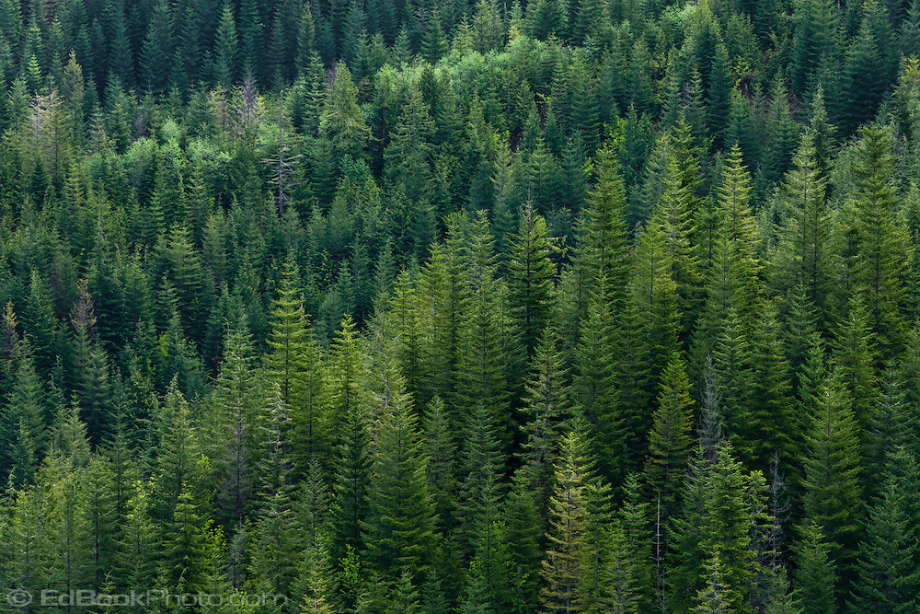
Our Research Questions:
1) Can we create a simple model that qualitatively replicates eastside vs westside fire dynamics?
2) Which parameters are most important for generating these differing dynamics?
Image source
Notes:
Source:

Slide 5
Presentation Roadmap
Ecological Context
Model Description
Experiments + Results
Conclusions
Notes:
H – Ecological context + model description
J – Experiments and Results + conclusions

Slide 6


Model Set up
Cellular automata model on 2d grid
Fixed boundary conditions
Each cell takes on a biomass value
varies between 0 and its maximum biomass
ASH
VEGETATION

Slide 7

Simulation
GROWTH SEASON
FIRE SEASON
Before
Alternate between growth season and fire season for n years
usually takes around 500 for dynamics to stabilize
Growth season: Vegetation increases in biomass and propagates to new cells
Fire season: Fires ignite, spread and burn out
After

Slide 8
Presentation Roadmap
Ecological Context
Model Description
Experiments + Results
Conclusions
Notes:
H – Ecological context + model description
J – Experiments and Results + conclusions

Slide 9
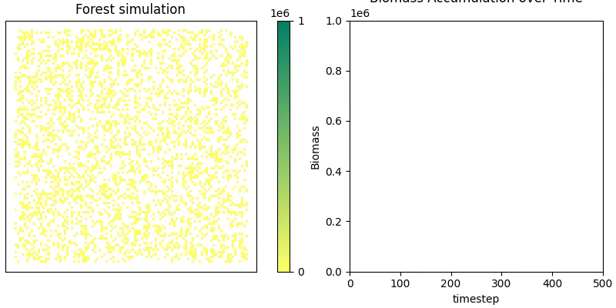
Biomass accumulation over time

Slide 10
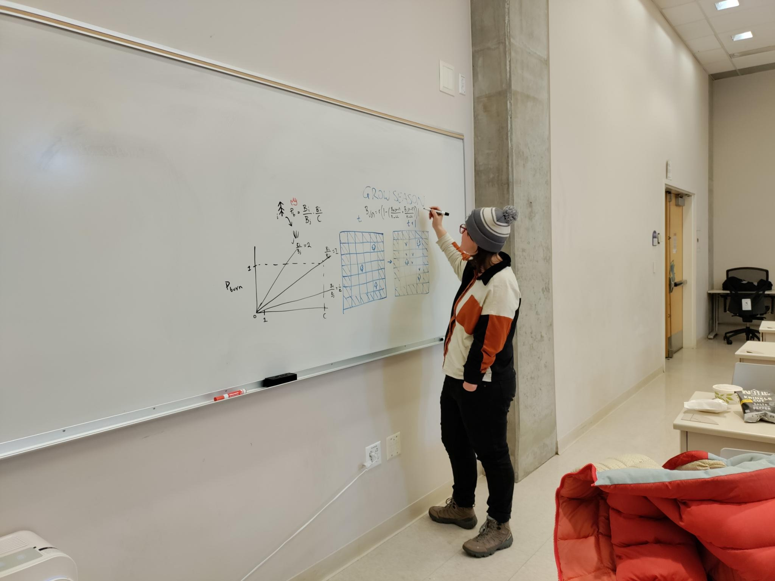
Experiments
2) Eastside vs Westside dynamics
1) Parameter Sweeps

Slide 11
Experiment Set #1: Parameter Sweeps
Vary:
Max Biomass Ratio
Intrinsic growth rate
Tree Max Biomass
Ignition Probability
Max
Mean
Min
Visual:
Biomass
Parameter value

Slide 12
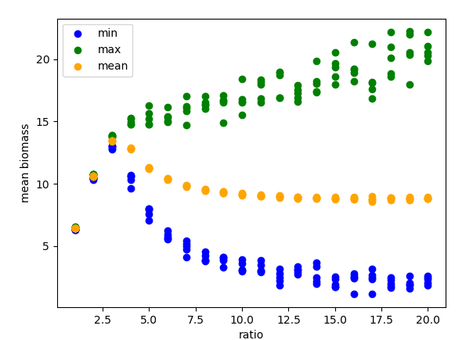
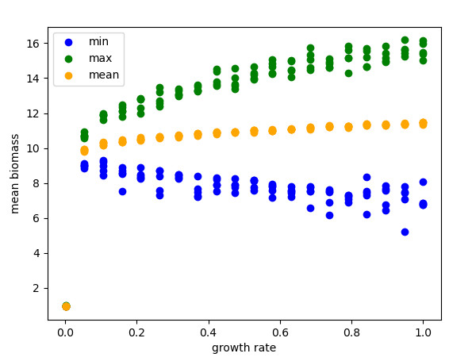
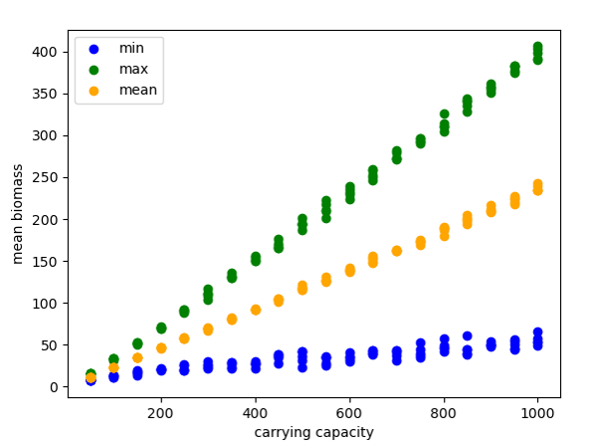
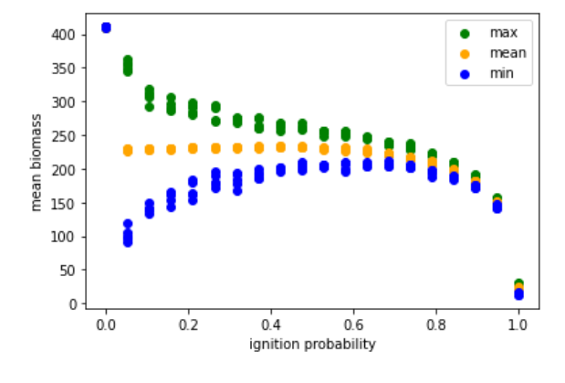
Max Biomass Ratio
Intrinsic Growth Rate
[plots + interpretation]
Change in dynamics
Tree Max Biomass
Ignition Probability
Bigger gap = bigger oscillations
Notes:
Qualitative differences:
Higher growth rate = more oscillations
Two dynamics: At low nieghborhood carrying capacity (like resource competition) – no oscillations; higher is oscillations
Ignition probability – lower = more oscillatory (at 1 everything burns all the time)

Slide 13
Experiment Set #2: Eastside vs Westside Dynamics
Vary:
Hand-picked “westside” vs “eastside” parameters
For a characteristic time point:
Over time:
Over time:
Visual:
Biomass
Freq
Freq
Time
Area burned
Patch size

Slide 14
[plots]

Slide 15
Presentation Roadmap
Ecological Context
Model Description
Experiments + Results
Conclusions
Notes:
H – Ecological context + model description
J – Experiments and Results + conclusions

Slide 16
Conclusions
The Good:
Our model did recover some environmental differences (more resource limited system/smaller burns vs less limited/bigger burns)
The main parameters that seem to drive differing dynamics are ratio of max tree to neighborhood biomass (representing resource limitations) and ignition probability

Slide 17
Conclusions
The Limitations:
Linear relationship bt source size and probability of fire spreading caused semi-unrealistic dynamics
Tiny little grass fires almost never propagate bc of how we generate burn probabilities
More realistic would maybe be to have a non-linear relationship
Would not use fixed boundary conditions next time (artifacts on edges)

Slide 18
Thank you!

Slide 19
Questions?

Slide 20
Model Setup
Cellular automata model on a 2-D grid
Fixed boundary conditions (natural barriers)

Slide 21
Fire season
Before
Ignitions
Ignitions

Slide 22
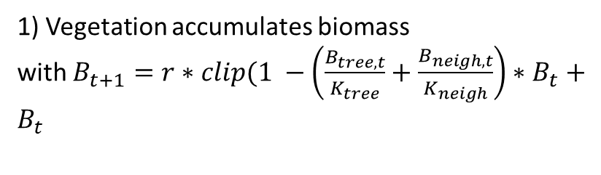
Growth Season
1) Vegetation accumulates biomass
with $B_{t+1}=r∗clip(1 −\left(\frac{B_{tree, t}}{K_{tree}}+\frac{B_{neigh, t}}{K_{neigh}}\right)∗B_{t}+$ $B_{t}$
After
Before
2) Vegetation propagates in neighboring cells
3) Vegetation spontaneously grows in empty cells

Slide 23
Conclusions
Our model is fine
Main parameters that seem to drive diff dynamics are: ratio,
[more stuff]
“Your model is sick. Super sick man!” – Brooke Nelson

Slide 24
Experiment Set #1
Varying ratio of tree_CC / neighborhood_CC
Varied from 1-20
Made a cool plot of mean, max, min biomass
Found: when ratio < 3, do not see oscillations in biomass; when ratio >3, we do (and amplitude of oscillations increases with ratio)
HOWEVER, mean biomass does not continue increasing after ratio >3

Slide 25
Experiment #2
(choose CCratio to be 5)
Varying intrinsic rate of growth between (almost) 0 and 1
Result: no qualitative change to mean/min/max biomass dynamics over time, but oscillations in biomass got larger with higher growth rate

